Slide 1
How to handle exceptions and validate data
Chapter - 7

Slide 2
Exception handling

Slide 3
How exceptions work
An exception is an object that's created from the Exception class or one of its subclasses.
Exception objects represent errors that have occurred, and they contain information about those errors.
A well-coded application will catch any exceptions that might be thrown and handle them. This is known as exception handling.

Slide 4
How exceptions work
When you're testing an application, it's common to encounter exceptions that haven't been handled.
In that case, Visual Studio will enter break mode and display an Exception Assistant dialog box like the one shown in the next slide.
This dialog box includes the name of the class for the exception, a brief message that describes the cause of the exception, and some troubleshooting tips to help you fix the problem that caused the exception to be thrown.

Slide 6
The exception class
All exceptions are subclasses of the Exception class. For example, the FormatException class is a subclass of the Exception class that represents a specific type of exception that occurs when a value of one data type can't be converted to another data type. This exception can be thrown by the To methods of the Convert class or the Parse method of any class.
The ArithmeticException class is also a subclass of the Exception class. It represents an exception that occurs during an arithmetic, casting, or conversion operation.
This class contains other subclasses, including the OverflowException and DivideByZeroException classes shown here. An overflow exception occurs when the result of an arithmetic, casting, or conversion operation is too large for the receiving variable. A divide-by-zero exception occurs if an application attempts to divide a number by zero.

Slide 9
How to display a dialog box
One way an application can communicate with its users is by displaying a dialog box that contains a message.
Dialog boxes are used to display messages about exceptions that have occurred.

Slide 11
How to use structured exception handling
To prevent your applications from crashing due to runtime errors, you can write code that handles exceptions when they occur.
This is known as structured exception handling, and it plays an important role in most applications.

Slide 12
How to catch an exception
Next slide shows how to use try-catch statements to catch and handle exceptions.
First, you code a try block around the statement or statements that may throw an exception.
Then, immediately after the try block, you code a catch block that contains the statements that will be executed if an exception is thrown by a statement in the try block. This is known as an exception handler.

Slide 18
How to catch specific types of exceptions
In some cases, the statements in the try block of a try-catch statement can throw more than one type of exception.
Then, you may want to handle each exception differently. To do that, you can code catch blocks like the ones shown in following slide.

Slide 21
How to throw an exception
Now that you've learned how to catch exceptions, you're ready to learn how to throw exceptions from the methods that you code.
To do that, you can use the throw statement
You can use this statement either to throw a new exception or to throw an existing exception.
To throw a new exception, you code the throw keyword followed by the new keyword and the name of the exception class you want to create the exception from.

Slide 24
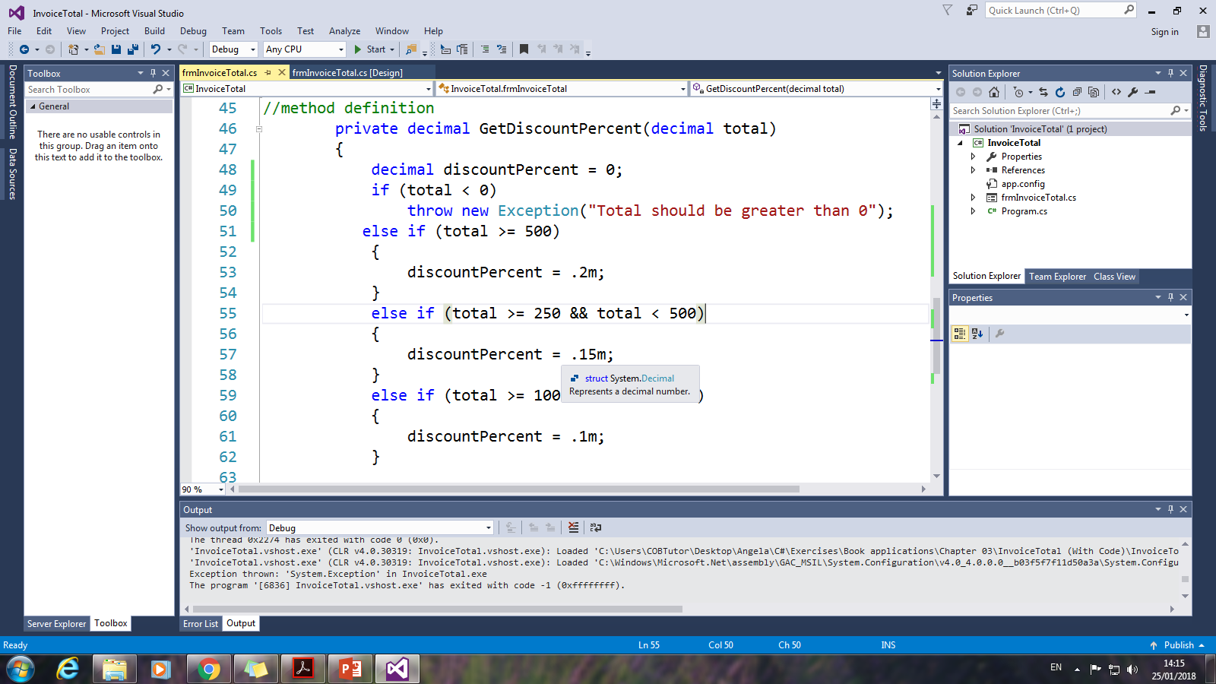

Slide 25
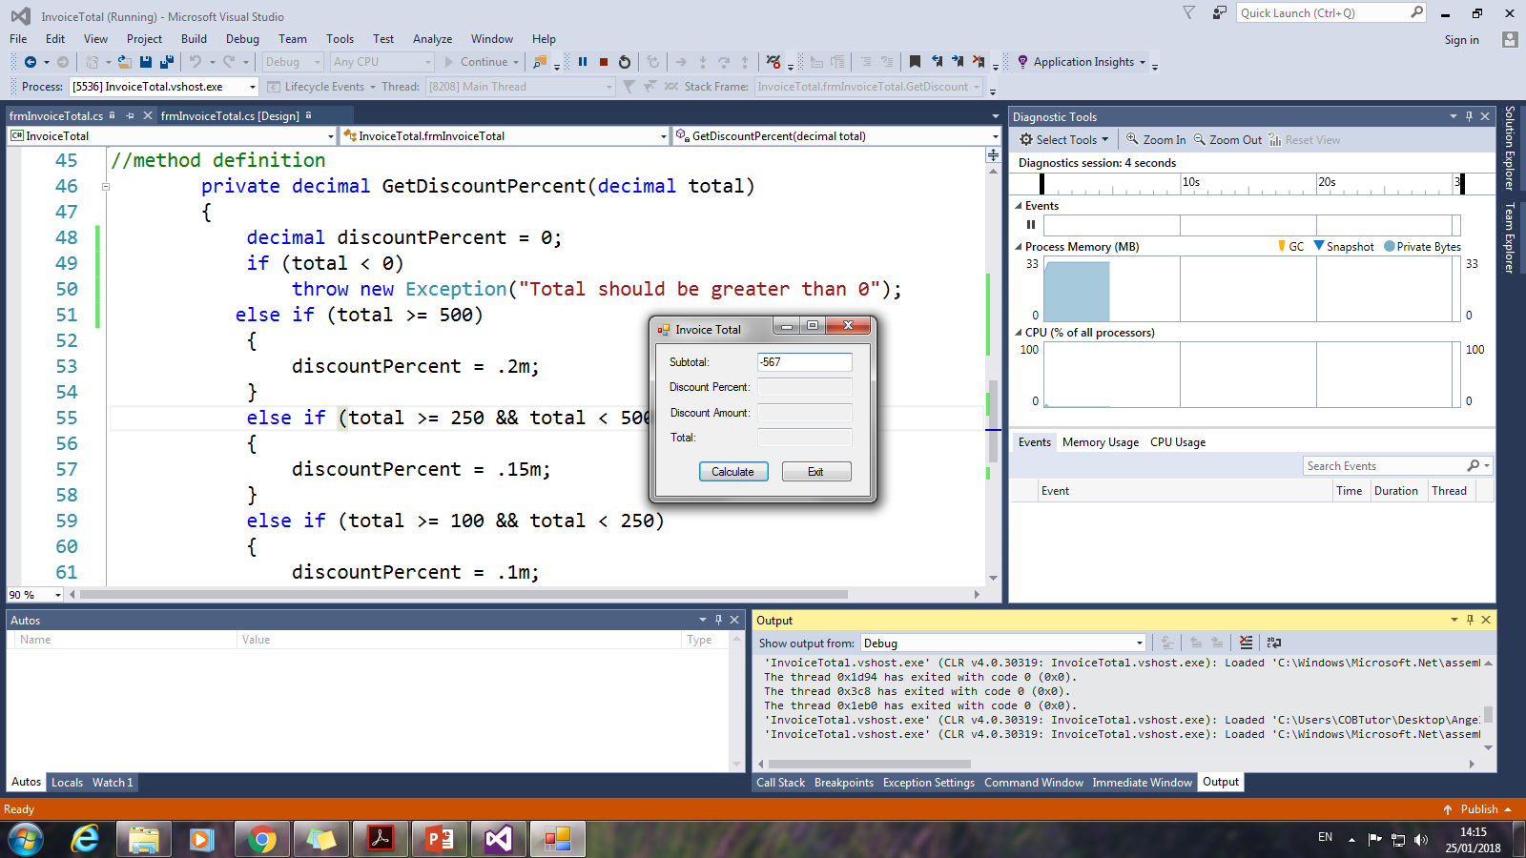

Slide 26
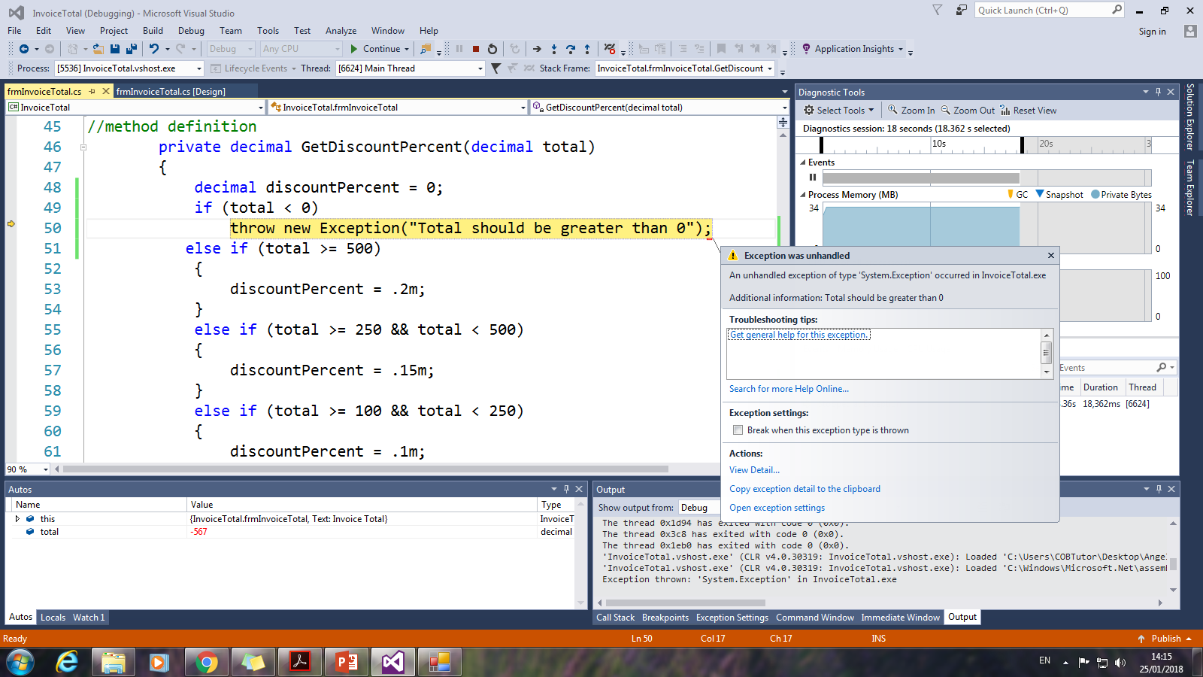

Slide 30
Entire code for invoice total with exception handling

Slide 31
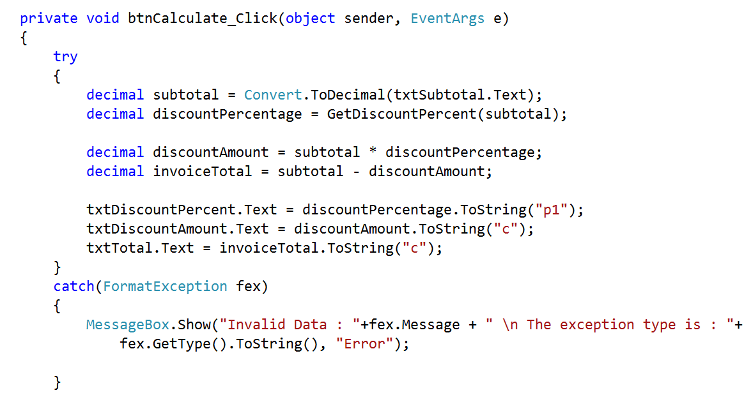

Slide 32
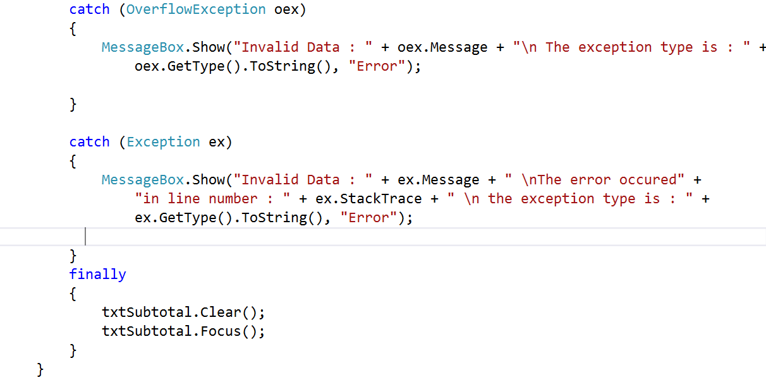

Slide 33
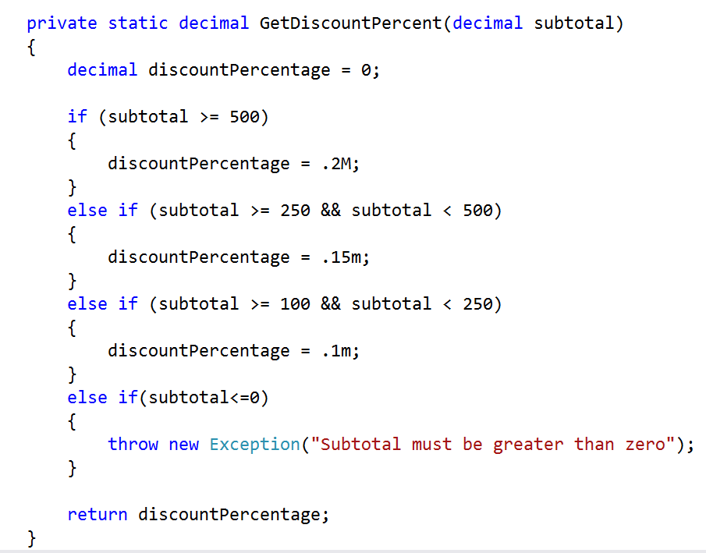

Slide 34
Data validation

Slide 35
How to validate data
Whenever a user enters data, that data usually needs to be checked to make sure that it's valid. This is known as data validation.
When an entry is invalid, the application needs to display an error message and give the user another chance to enter valid data. This needs to be repeated until all the entries on the form are valid.

Slide 36
How to validate a single entry
When a user enters text into a text box, you may want to perform several types of data validation.
In particular, it's common to perform the three types of data validation

Slide 37
Three common types of validity checking
(1) To make sure that a required entry has been made
To test whether a value has been entered into a text box, you can check whether the Text property of the box is equal to an empty string.
(2) To make sure that an entry has a valid numeric format, and
To test whether a text box contains valid numeric data, you can code an if statement with a condition that tests if a TryParse statement that converts the data is successful.
(3) To make sure that an entry is within a valid range (known as range checking).
To test whether a value is within an acceptable range, you can use if-else statements.

Slide 41
How to write generic methods for data validation
Since it's common to check text boxes for valid data, it often makes sense to create generic methods like the ones shown the next slide for data validation.
These methods perform the same types of validation described in the previous figure, but they work for any text box instead of a specific text box.

Slide 46
How to validate multiple entries
Following Figure shows two ways to code a method named Is ValidData that validates multiple entries on a form.
The methods shown here validate the Monthly Investment and Interest Rate text boxes on the Future Value form using the three methods you saw in slides 38,39 &40.
Although these methods only check two text boxes, you can use methods like these to check every entry on a form for validity. That way, all the data validation for the form is coded in one location, which makes the code easy to read and maintain.

